Slide 1
Waste management around us
RISHIKA SINGH
SHRISTI PODDAR
KAJOL CHORDIYA
RANYA NARULA
ADITI JAISWAL

Slide 2
LEAST CONTRIBUTION

Slide 3
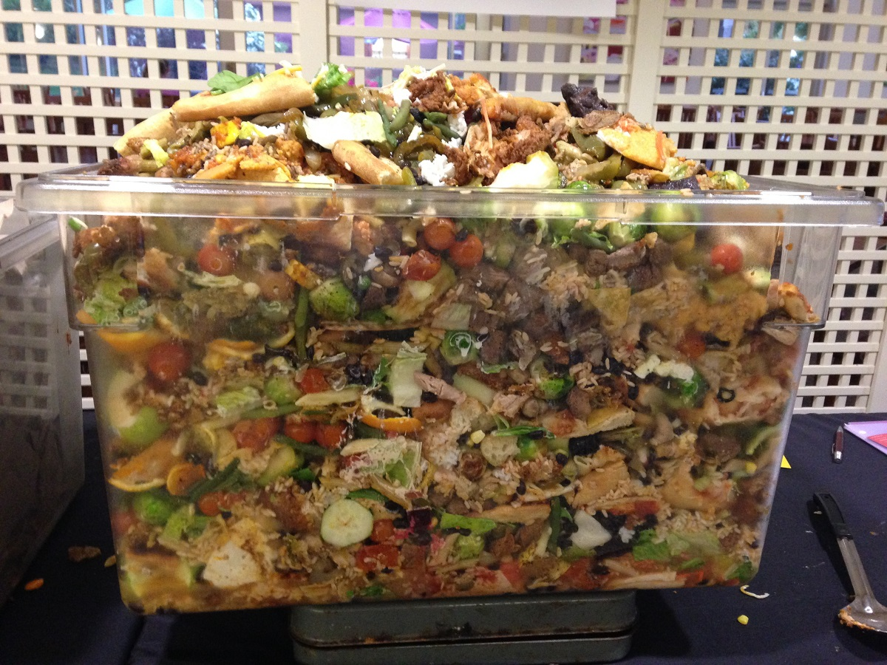
RESTAURANTS
LEFT OVER FOOD (DRY) FROM ONE DAY OF BUSINESS AT Image restaurant, Mumbai.

Slide 4
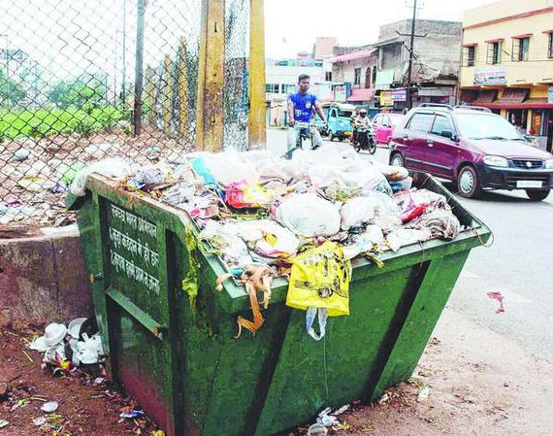
NO SEGREGATION

Slide 5
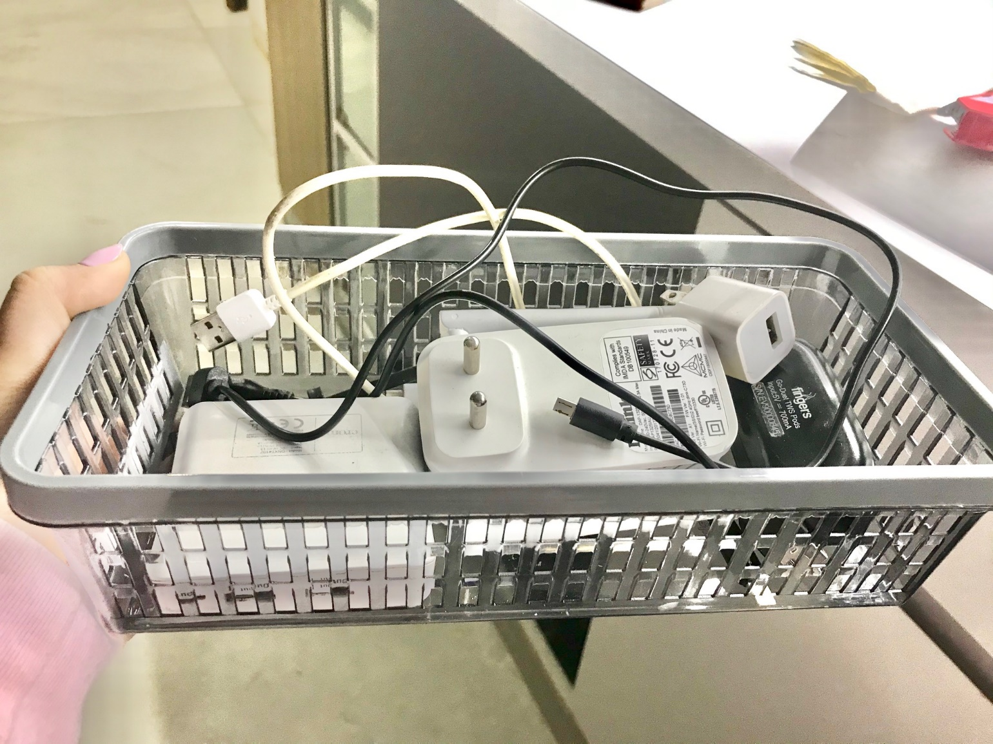
E- waste
Croma- tied up with "just dispose"- Maharshtra pollution board.
Ecoreco

Slide 6
MAXIMUM CONTRIBUTION

Slide 7
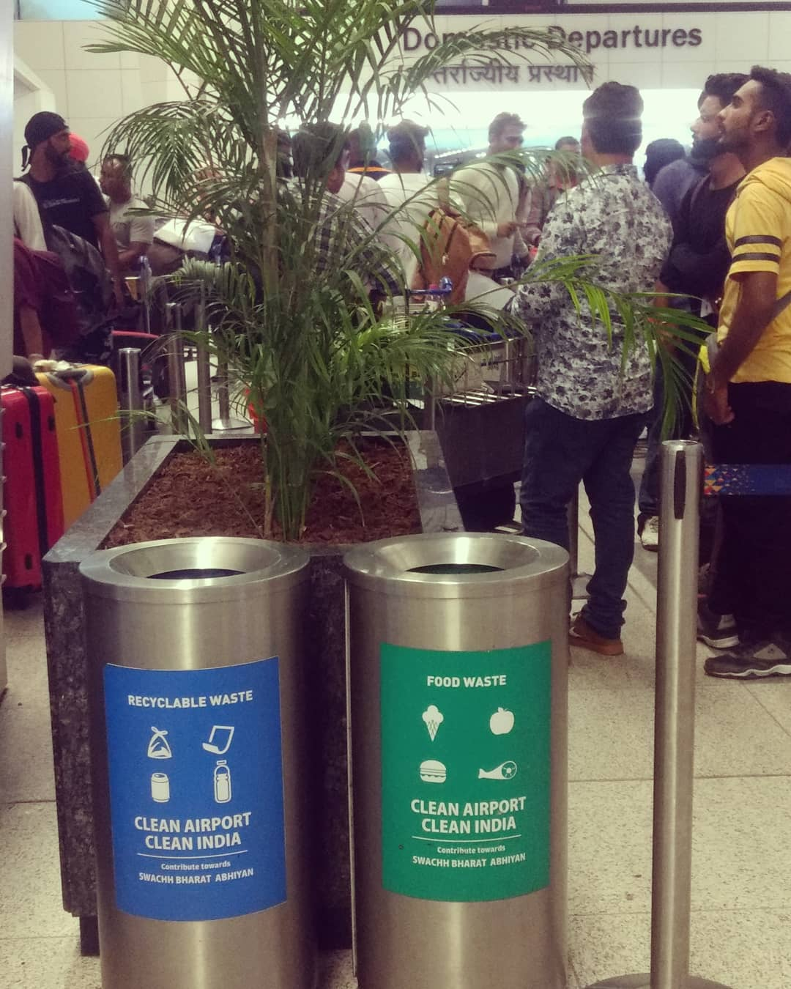
Segregation:
WET WASTE
DRY WASTE
E- WASTE

Slide 8
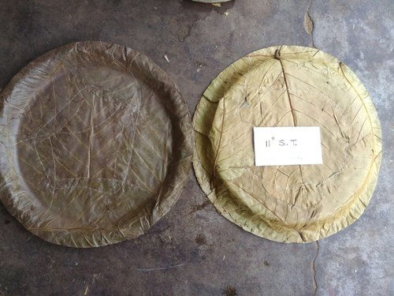
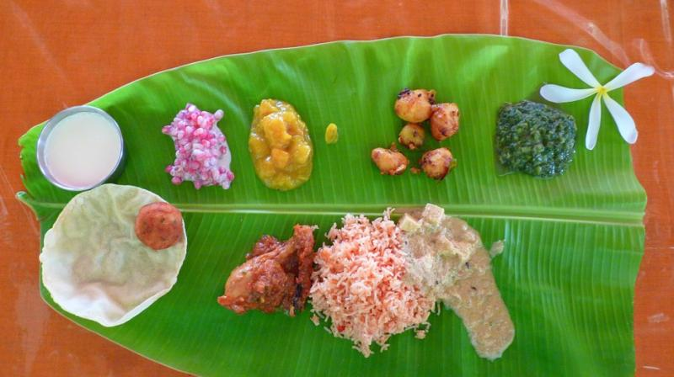
USING LEAVES AS PLATES

Slide 9


Slide 10


Slide 11


Slide 12
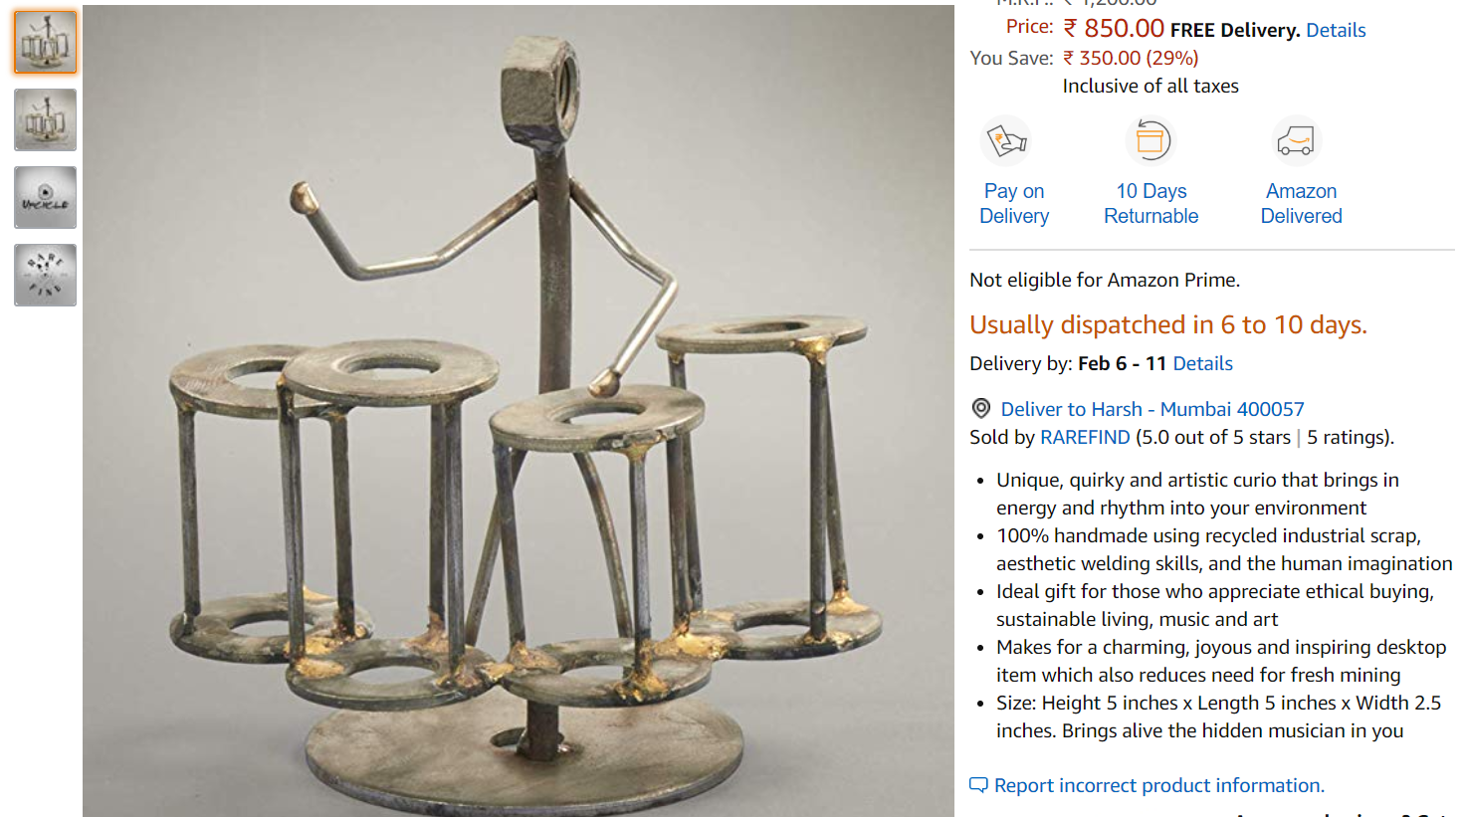
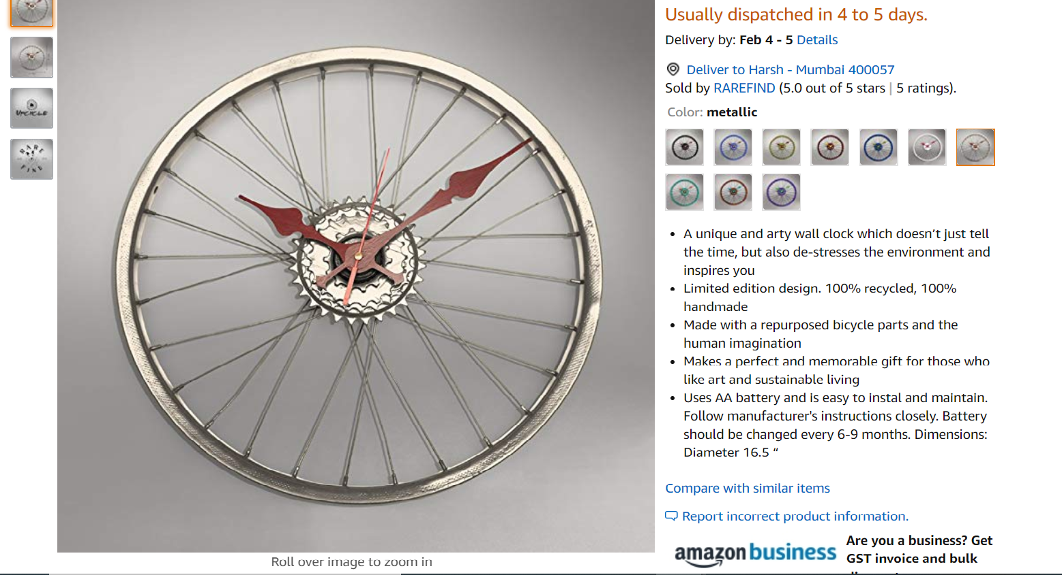
UPCYCLE

Slide 13
Ways to manage waste at personal levels

Slide 14
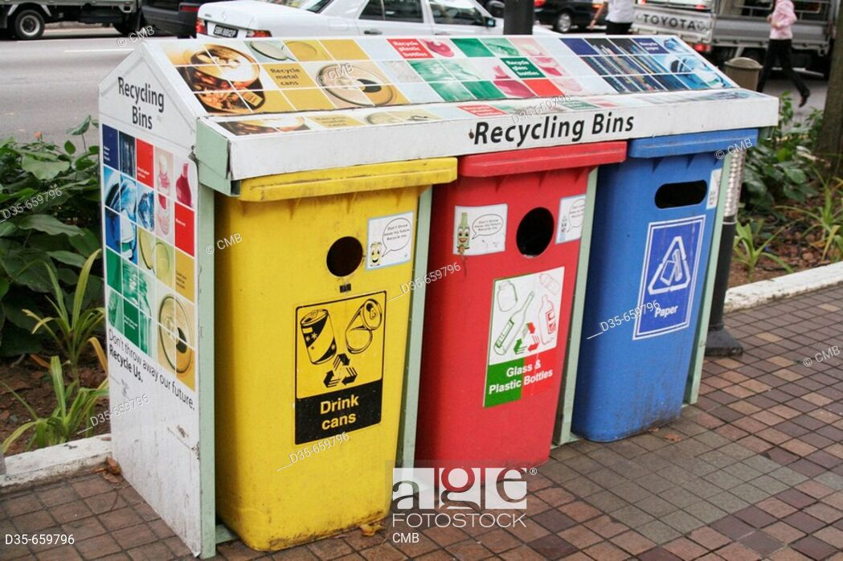
Promoting segregation via Illustrative bins
Local language
Infographics
Colours
interaction

Slide 15

Langar donations
Dhyan foundation
Khalsa aid (int)
donateinkind.com

Slide 16
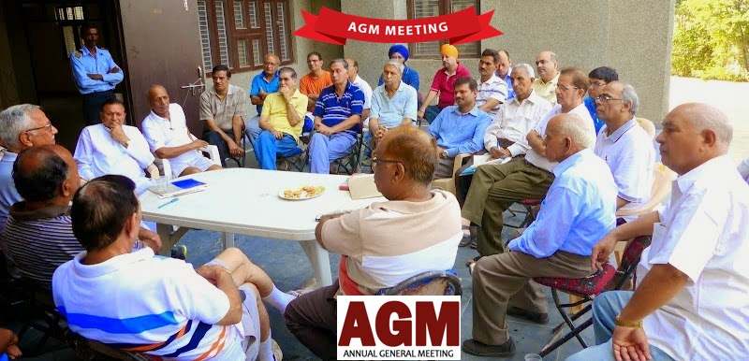
Societal meetings to address - waste management & spreading awareness

Slide 17
