Slide 1
WASTE MANAGEMENT

Slide 2
Aims
Looking at how the residential, commercial and mixed sectors deal with their waste.

Slide 3
IDENTIFYING STAKEHOLDERS:
B M C authorities
Ourselves as residents of the city
SOCIETAL AUTHORITIES

Slide 4
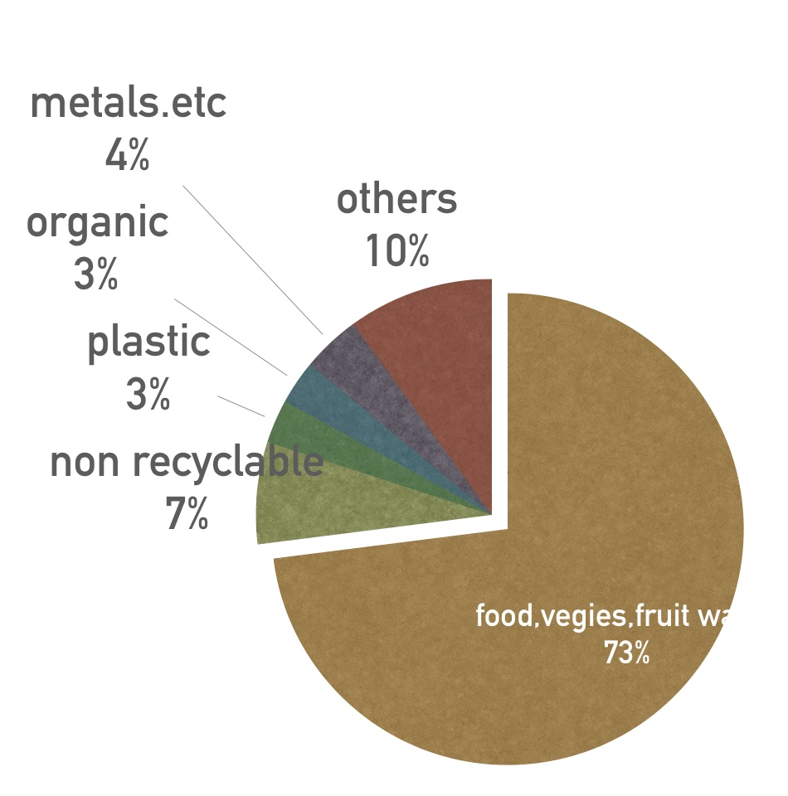
IMPACT OF WASTE
Type of waste that gets dumped in Mumbai everyday –
It is estimated that the Mumbai region alone generates one-third of the total waste generated in Maharashtra
Of the 9,400 tonnes of trash that Mumbai sends daily to its dumping grounds , 73% comprises food, vegetable and fruit waste
organic domestic waste poses a serious threat, since they ferment, creating conditions favourable to the survival and growth of microbial pathogens.
Direct handling of solid waste can result in various types of infectious and chronic diseases.
https://www.hindustantimes.com/mumbai-news/bmc-finds-73-of-mumbai-s-garbage-is-food-waste-two-years-in-a-row/story-7Dls4uyotbmzUXuDULKGHI.html

Slide 5
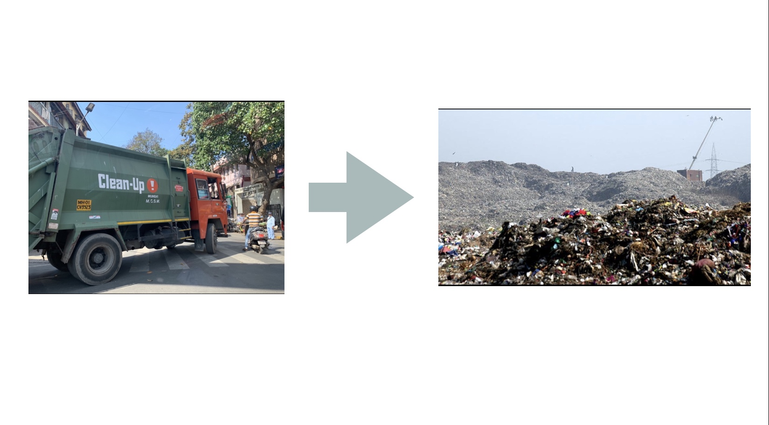
Waste dumped near a water source also causes contamination of the water body or the ground water source
Uncollected solid waste can also obstruct storm water runoff, resulting in the forming of stagnant water bodies that become the breeding ground of disease.
Waste management experts said if Mumbai recycles this waste, it can reduce the amount of garbage transported to its overburdened landfills by 93%. “Not more than 7% of non-recyclable and inert waste requires to be dumped at landfills in Mumbai because they can be treated at source

Slide 6
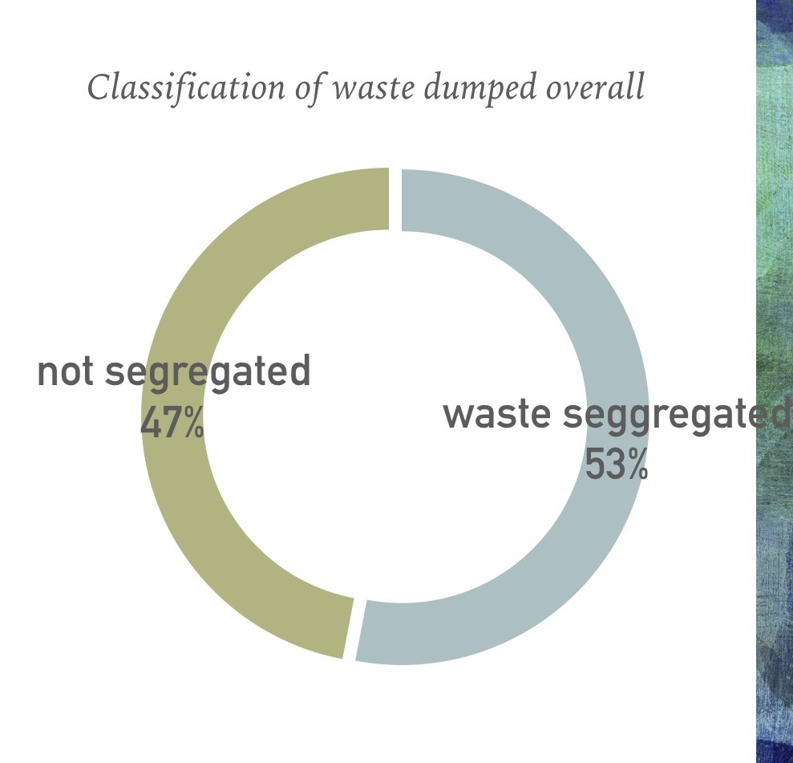
Despite the high proportion of recyclable components in its garbage. Mumbai segregates only 8% for recycling and only 5% is composted by private agencies such as housing societies, restaurants and produce markets.
The dumping of garbage poses health hazards because it is a breeding ground for mosquitoes, flies, and rodents, which are carriers for disease-causing pathogens. It also aggravates air pollution, ground water pollution and soil pollution affecting the fragile ecosystem.

Slide 7
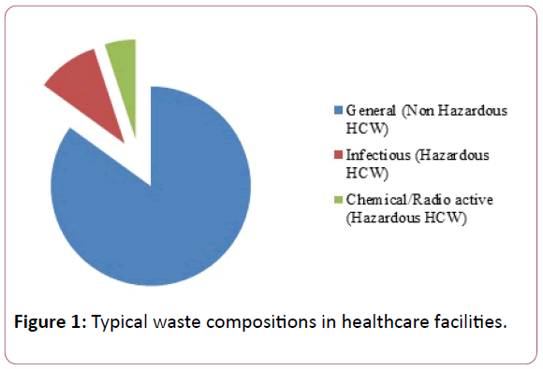
waste generated from the hospitals, health care centres, medical laboratories, and research centres such as discarded syringe needles, bandages, swabs, plasters, and other types of infectious waste are often disposed with the regular non-infectious waste.
Exposure to hazardous waste can affect human health, children being more vulnerable to these pollutants
https://www.indianfolk.com/waste-management-mumbai-fails-edited/

Slide 8
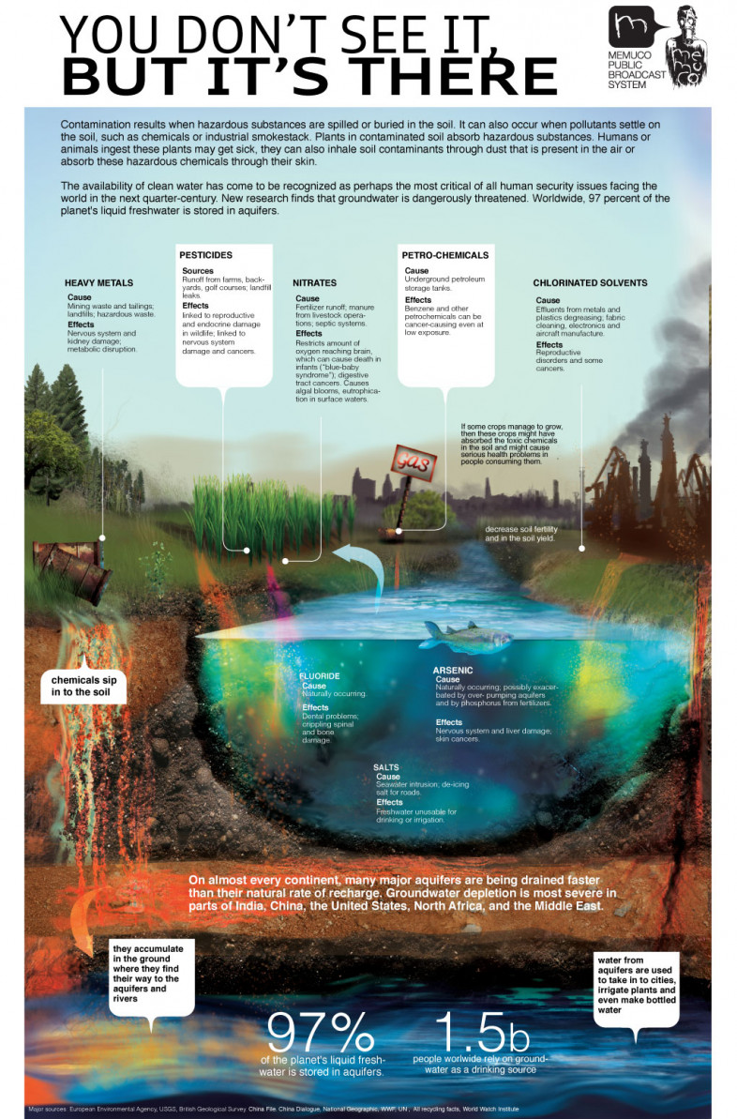
https://www.metropolitantransferstation.com.au/blog/negative-effects-of-improper-waste-management

Slide 9
CASE STUDIES :

Slide 10
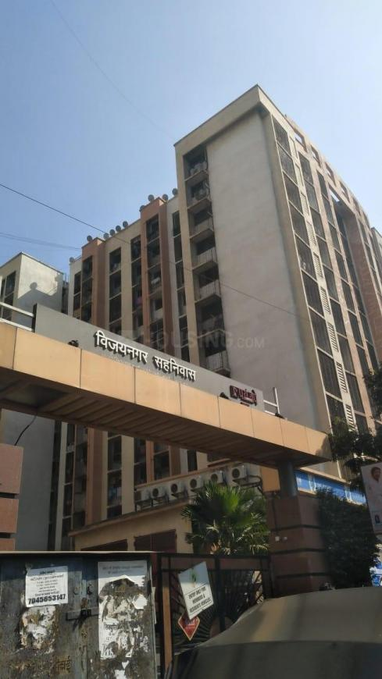
This Mumbai Housing
Society Generates
Zero Waste.
Vijay Nagar Housing Society in Andheri
Source:
https://swachhindia.ndtv.com/mumbai-housing-society-generates-zero-waste-thanks-one-simple-trick-6512/

Slide 11
Mumbai’s Vijay Nagar Housing Society is a success story that India can easily adopt.
The society used to generate around 8,700 kg of garbage every month, all of which went straight to the landfills.
Now, thanks to their ‘Zero Garbage’ policy, less than 10% of waste is being sent for dumping.

Slide 12
So what triggered this huge change?

Slide 13
Way back in 2015, the BMC (Brihanmumbai Municipal Corporation) had put two garbage bins in front of their society gate.
There are around 2,000 people living in their society and these bins used to fill up quickly, resulting in endless bad odour.
they demanded the removal of these bins. The BMC agreed but said it will be done only if they could manage their waste effectively.
That’s when they started their mission of Zero Garbage
Source:
https://swachhindia.ndtv.com/mumbai-housing-society-generates-zero-waste-thanks-one-simple-trick-6512/

Slide 14
What followed next was months of hard work.
Many education drives were initiated in order to make the people of the society aware about the problems of bad waste management and how they can help.
distributed dustbins for dry garbage to all residents to emphasize the importance of segregating dry garbage. The housing society also built 10 compost pits with proper aeration and drainage system, adds Ms Sukruta.
(Ms Sukruta, a physics professor by profession, who is a volunteer of the Zero Garbage campaign.)

Slide 15
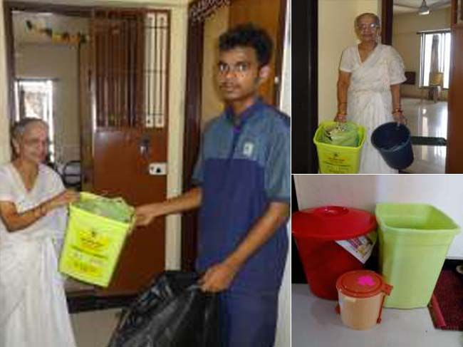
Unlike most other societies in the area, residents of the Vijay Nagar Housing Society have started segregating their waste at home.
This is a crucial step that has also been stated in the Solid Waste Management 2016 rules as well as the Swachh Bharat Abhiyan.

Slide 16
How The Zero Waste Model Is Reducing Waste Load From Overgrowing Landfills?
The housing society generates about 6,000 kg of wet waste
once composted is used as manure for the garden in their complex
They also sell the excess manure to corporates.
Dry waste of around 7,500kg is sent for recycling.

Slide 17
Problems they faced.
For the initial few months we faced an issue of foul smell at the composting sites.
But, after further research we manage to curtail these issues, added Ms Sukruta. Composting is a simple technique, which when done properly actually doesnt emit any foul order.

Slide 18
CASE STUDY 2

Slide 19
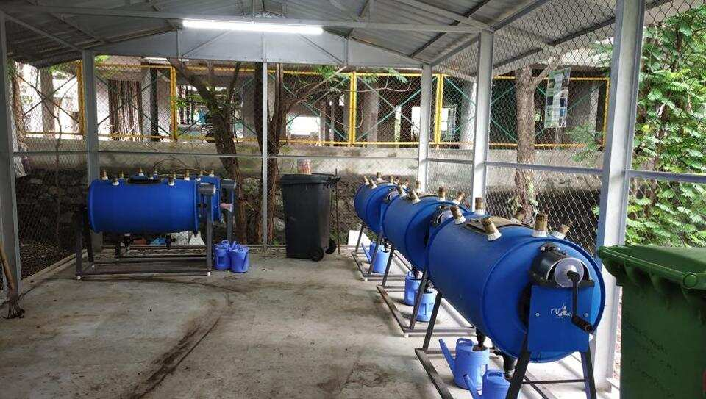
Chembur housing society-treats 90% of its trash at source
Over the past 15 months, a housing colony in Chembur has reduced 90% of their trash by handling it at source. With 300 residents, Green Garden Apartments mitigates over 65kg carbon dioxide generated by diesel vehicles transporting waste from source to dumping grounds, annually.
Residents of the Chembur society began their project in May 2018. They started to segregate waste at the household level into three bins – wet waste, dry waste and trash. Following this, 50kg of organic waste was converted into

Slide 20
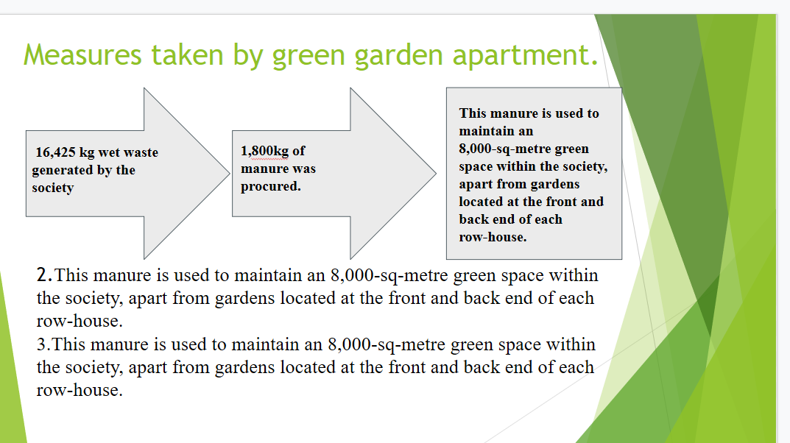

Slide 21
ISSUES
Mumbai is the city of glitz and glamor; of highrises and plush hotels. But underneath all that jazz, Mumbai grapples with a giant problem- waste management. The city’s faring poorly when it comes to handling proper, hygienic disposal of human and kitchen refuse. And if waste is handled it is not handled in a cost effective way and eco-friendly way. Also one reason may be the lack of toilets in slums and shanties, leading to open defecation. Mumbai releases around 2100 million litres a day of human waste into the Arabian Sea. This is nearly 7025 in tonnes. A lot of waste in generated in these multi storeyed societies and they face a lot of issues in dumping these wastes. The main issues the housing society is facing are-
People are not informed about waste segregation.
People do not want to change.
Evening if they are practising individually, the society as a whole is not.
The society’s management dumps it into the garbage trucks together.

Slide 22
CONCLUSION:
Making a difference.
As we saw Just one housing society in a megalopolis like Mumbai has managed to prevent about 90,000 kgs of garbage in a year from getting dumped straight into the landfills.
All they did was educate themselves and start the simple process of segregating their waste at home.
Source:
https://swachhindia.ndtv.com/mumbai-housing-society-generates-zero-waste-thanks-one-simple-trick-6512/

Slide 23
Recommendations.
PROPER TRAINING.
Amongst the local BMC workers- using regional language.
ILLUSTRATIVE BINS.
Use of more illustrative self explanatory bins.
SOCIETAL MEETINGS
Promoting and educating societies on waste segregation.

Slide 24
