Slide 1
Movies: 1966 - 1980
Pronami Khan
Surakshta Shetty
Shrishti Poddar

Slide 2
Introduction
The 1960s was the era of Dilip Kumar, Madhubala, Dharmendra, Shammi Kapoor, Prem Chopra, Rajendra Kapoor until the 1970s arrived. This decade was led by our very lovable, Amitabh Bachhan, Rajesh Khanna, Shashi Kapoor, Feroz khan, Rishi Kapoor, Jitendra and of course one of the many, Shatrugan Sinha. The 1980s brought Sridevi, Smita Patil, Amrita Singh, Anil Kapoor, Sanjay Dutt, Naseeruddin Shah, Om puri, Mithun and many more actors from this decade to fame. The movies that were delivered by each of these actors and actresses have been sought after.

Slide 3
In the 70’s, a wave of feminism took place and in each corner women were raising their voices and started getting education. 1970 was also the year where women were given equal rights in United States by allowing them to vote. Likewise, women were also showed empowered in Bollywood movies spanning across the Era of 1966-1980. Under this era great dramatic movies about social revolutions were being produced. To understand this era further, we were asked to see and analyze 5 movies; Sholay by Ramesh Sippy(1975), Mrigya by Mrinal Sen(1976), Chitchor by Basu Chatterjee 1976, Grih pravesh by Basu Chatterjee and Manthan (1976). Breaking each movie down I realized that every woman character had a very important role and served as a hero for social revolution. Women were empowered and outdated norms were being removed.
In Sholay we see how a “Thakkur” was acceptable of her widowed daughter-in-law to remarry to the protagonist ‘Jai’. This explains the advancements in the 70s. At the same time Basanti who was just a common village girl, rode a horse cart (symbolically manly) to earn livelihood, and had a bold stance and was very out spoken. She also gave a very tough chase to the dacoits before her horse cart broke down. She even managed to save Veerus life by dancing and singing till she fell unconscious. Hence Basanti’s character was not a helpless village girl but a very bold character.
In the movie Manthan, yet again the role played my Smrita Patil had a very bold and strong character. She too managed her own livelihood in the village my selling milk. She did not breakdown when her husband left her. She had self-respect. She refused to take money from Dr Rao when she was left with no money, a testament to her high self-esteem. She had an important role in the movie with bold dialgoues and scenes.
In the movie Chitchor, we encounter a village girl who is supposed to get married. She is young but educated. In the movie it shows that she is waiting for her class 10 board results. Her parents too understand her love for the common man and let her get married to the choice of her husband. Hence liberation from oppression of arranged marriage also empowers women.
In the movie Mrigya, the protagonist peforms a great “hunt” by killing the userpers and hence ends their tyranny. He kills him when they forcefully kidnap Mamta shamkar, the actress. For this he is hanged at the dawn which brought a ray of hope that situations were revolutionized and the women were safer and secure.
In the movie Grih Pravesh, we encounter two very strong female characters. One who is an educated young girl who works as a typewriter in a firm. She is seductive and does not hesitate to take the first step. Whereas on the other hand there is a devoted wife, who longs for a better house. She solely goes around the city in search of houses and reads newspapers. When the protagonist has an affair with the the typewriter and comes through his wife, she does not act out and has a broad perspective to the situation. Rather she asks him to make her come home.
These films showcase a revolution in social thinking towards women. Hence a Flagship era for women empowerment.

Slide 4
Our Movies
Sholay (1975) Manthan (1976) Chitchor (1976) Mrigya (1976)
Griha Pravesh (1979)

Slide 5
Mind Maps

Slide 6
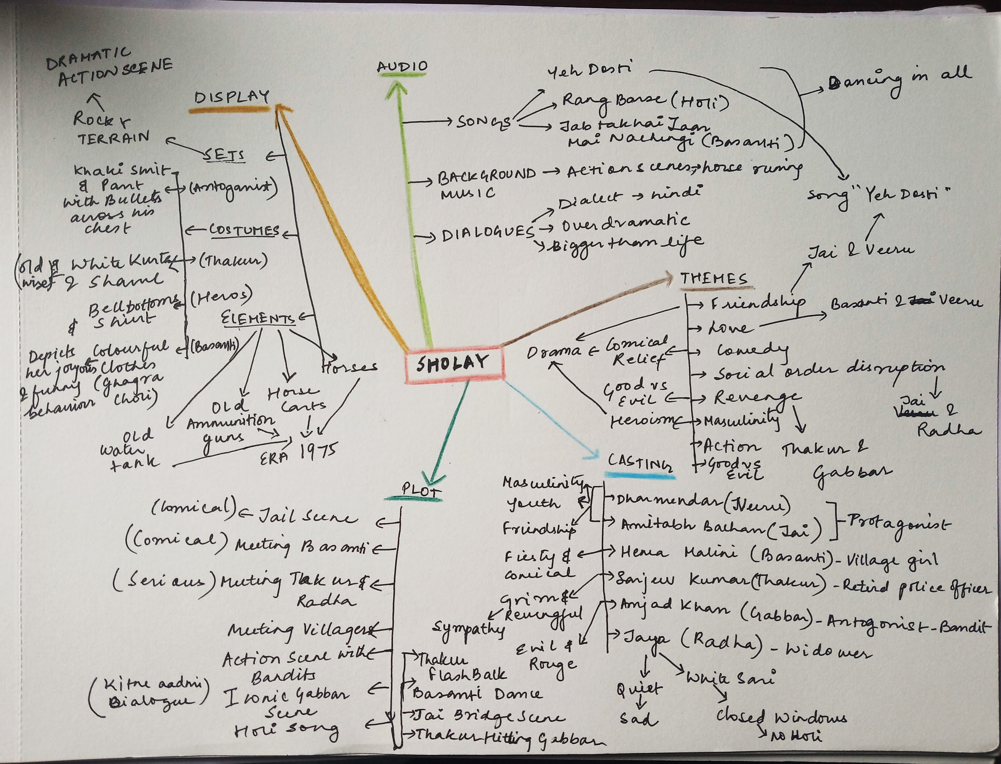
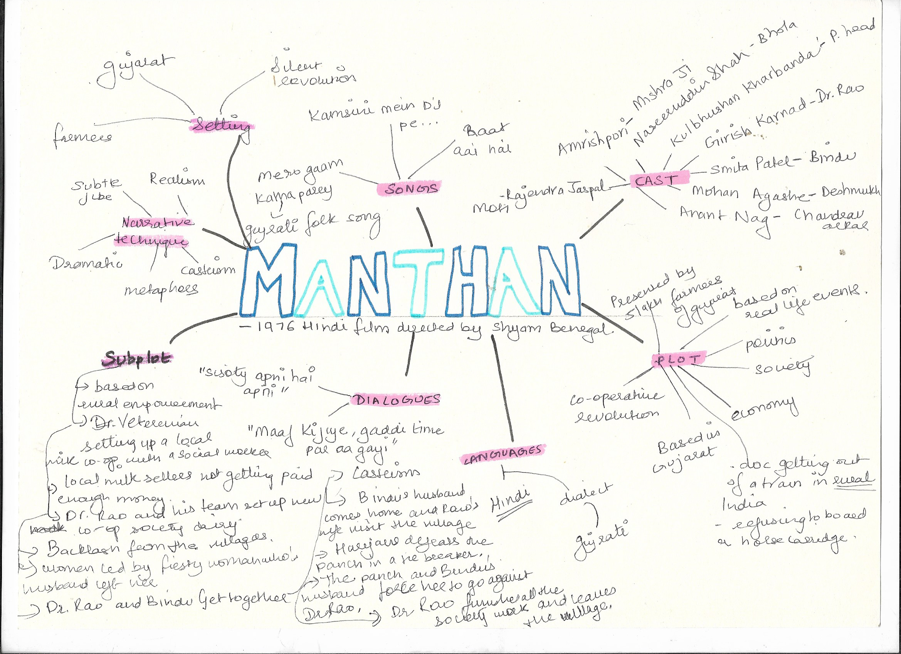
1.
Sholay
Manthan

Slide 7
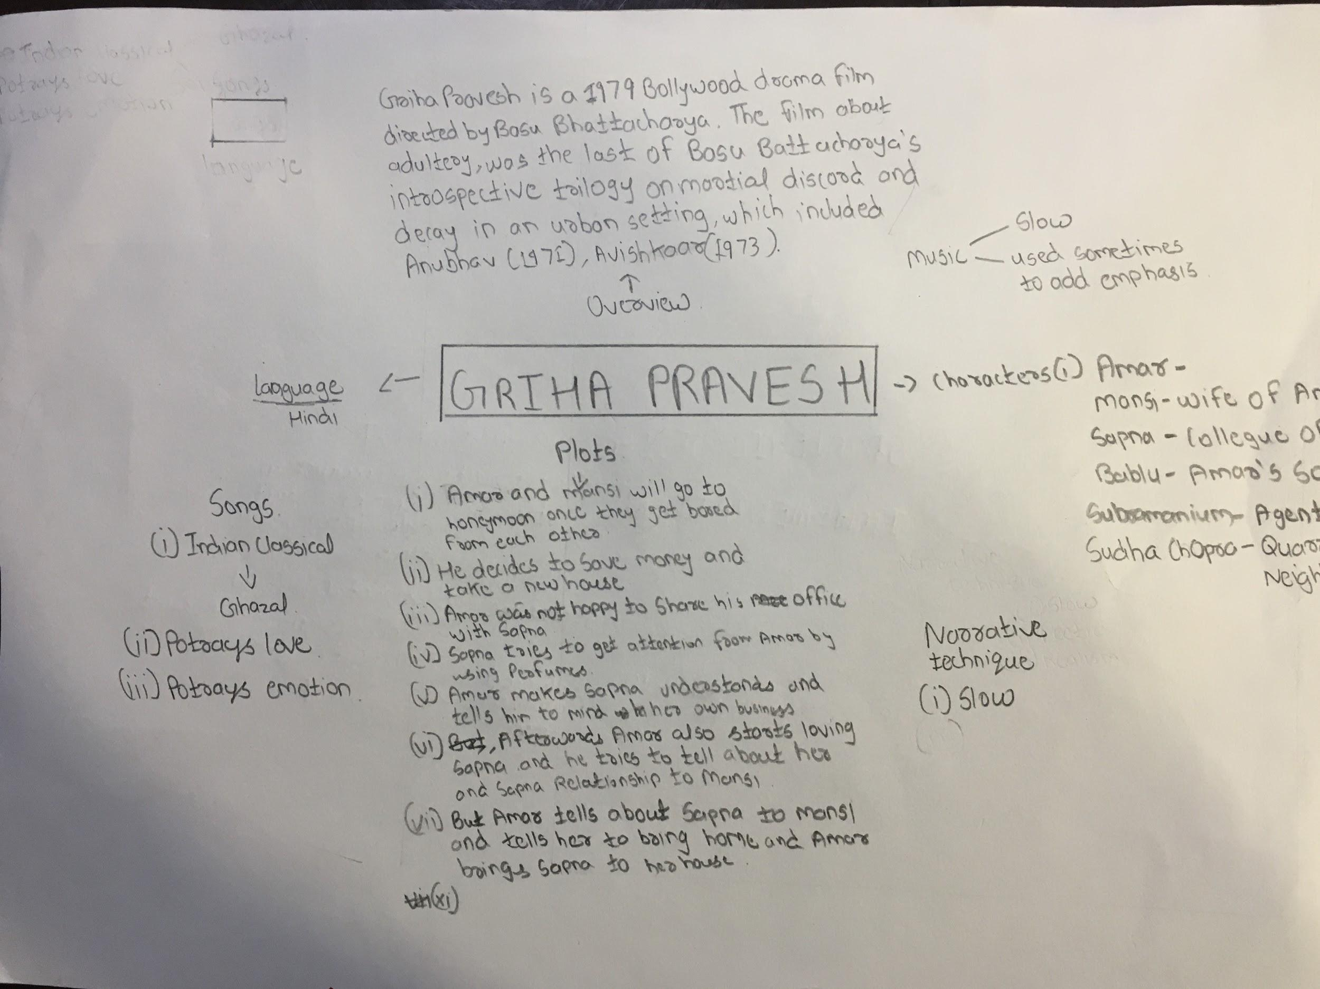
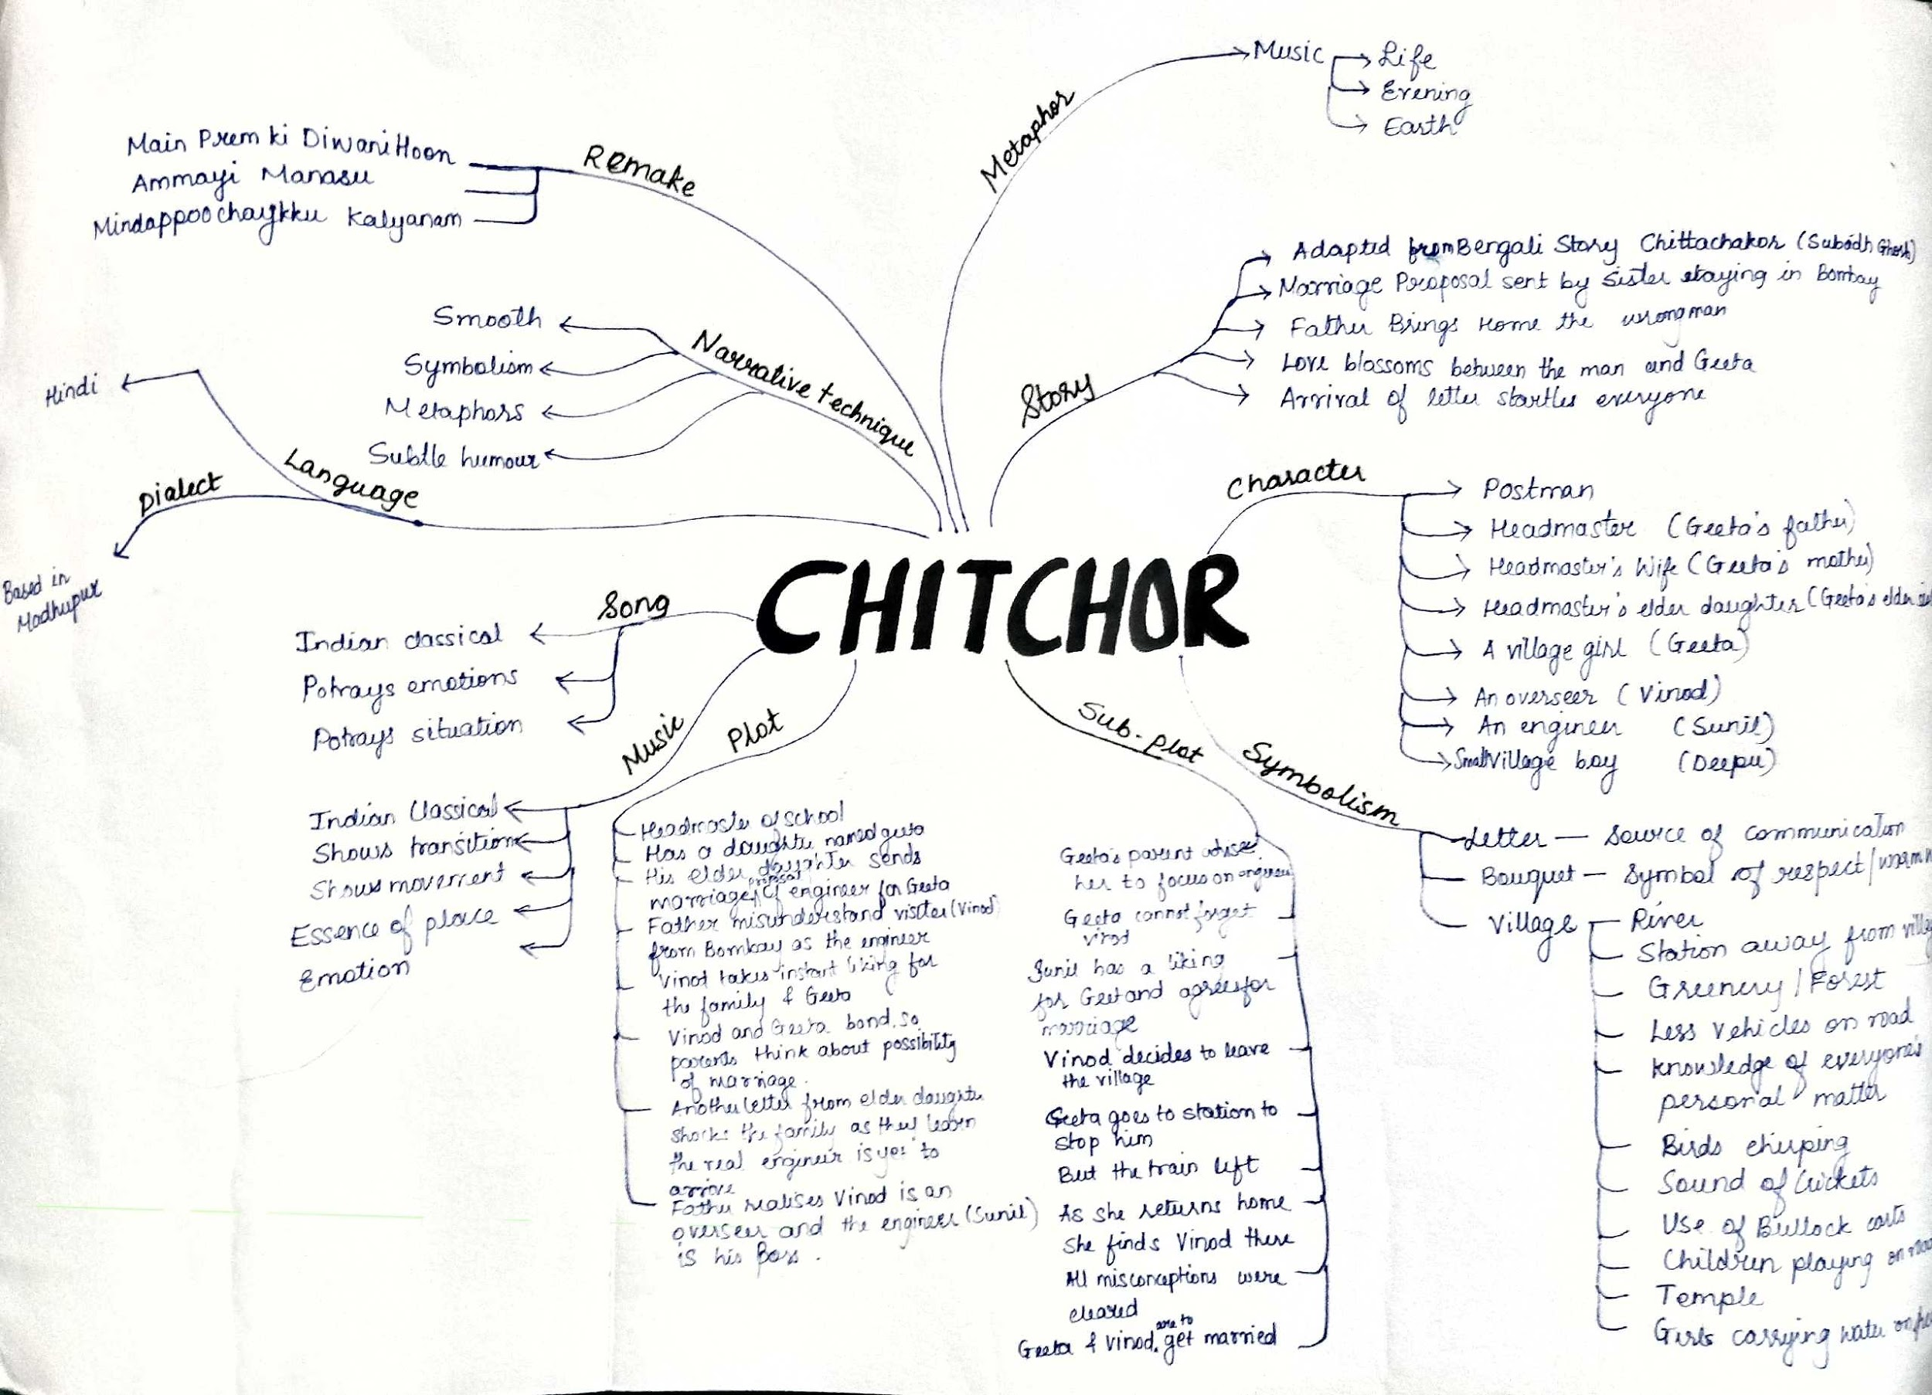
2.
Griha Pravesh
Chitchor

Slide 8
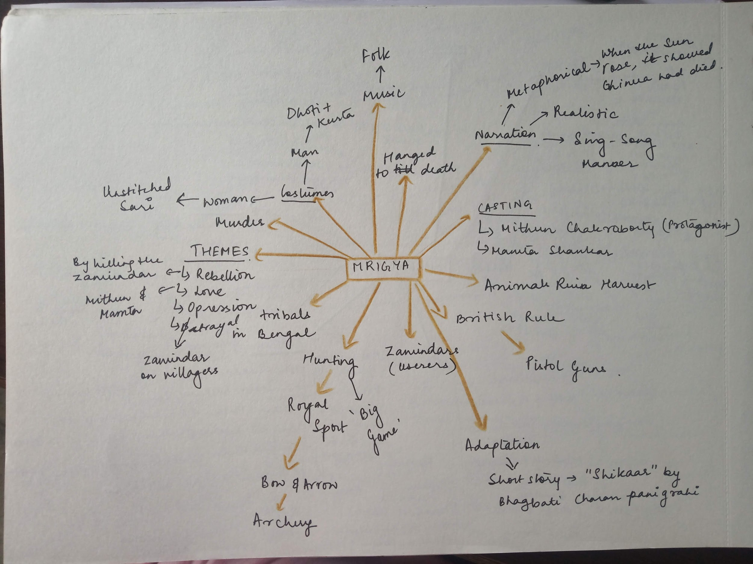
3.

Slide 9
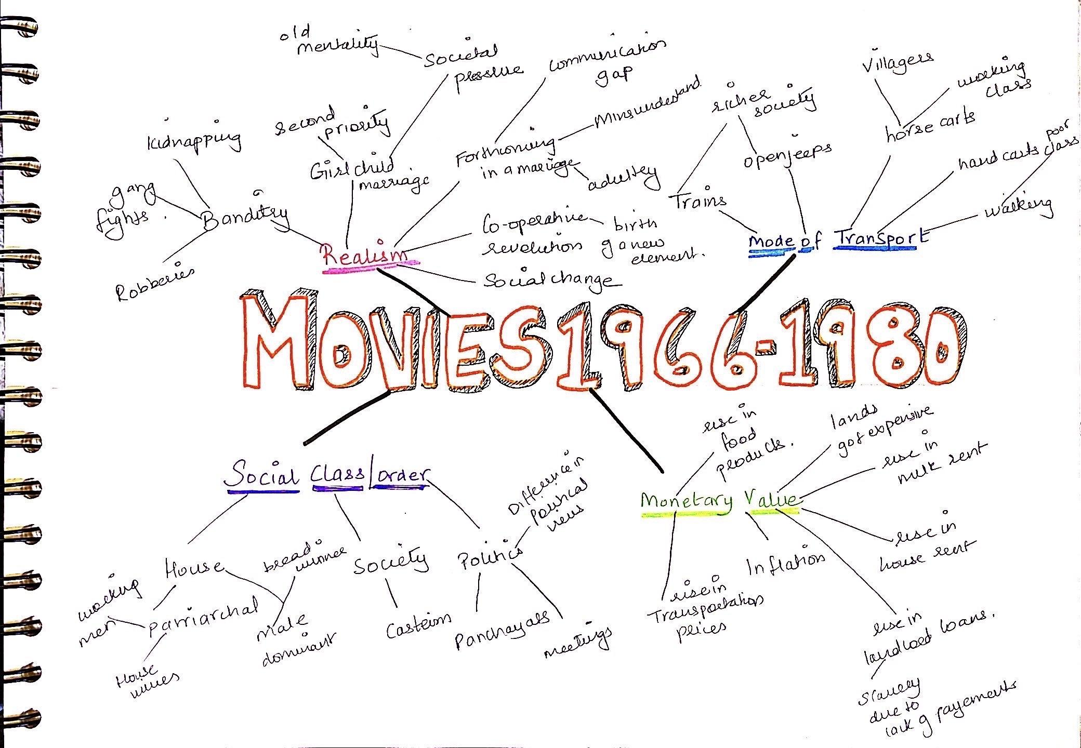
4.

Slide 10
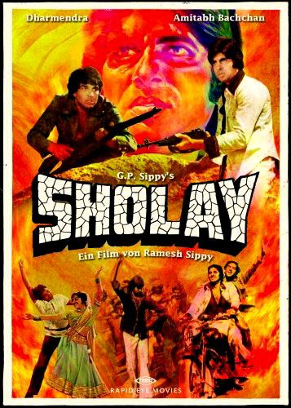
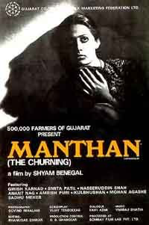
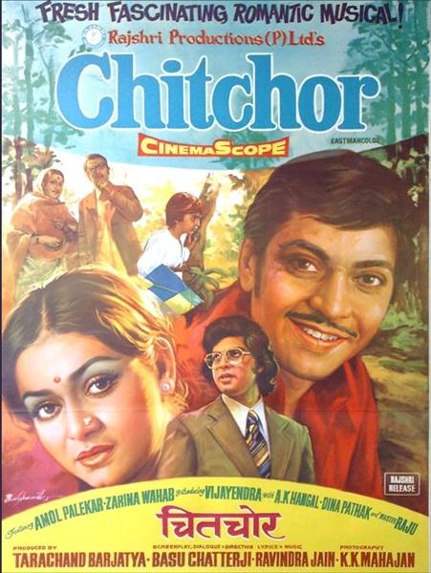
Original Movie Posters

Slide 11
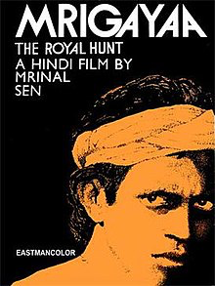
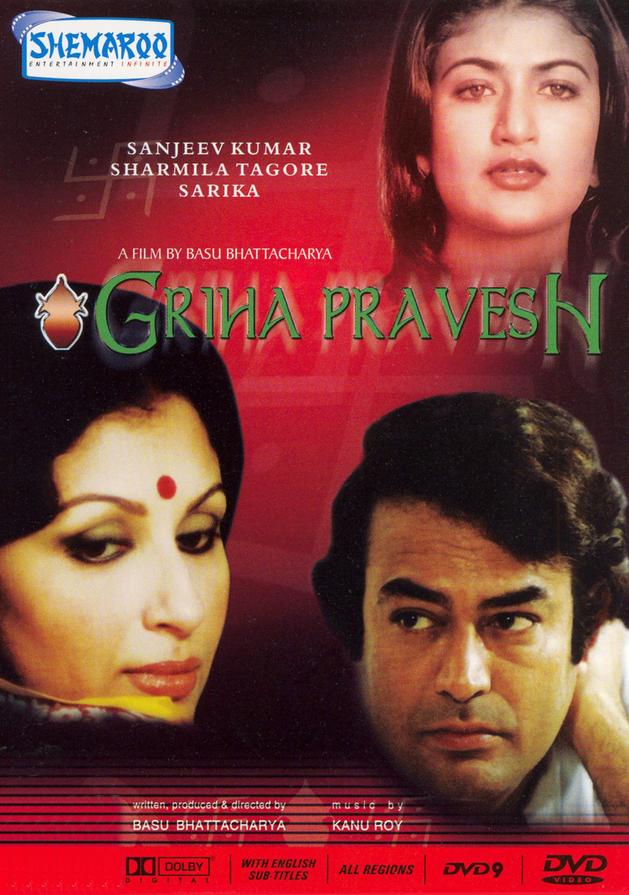
BIG CONCEPT
Bring the attention of your audience over a key concept using icons or illustrations

Slide 12
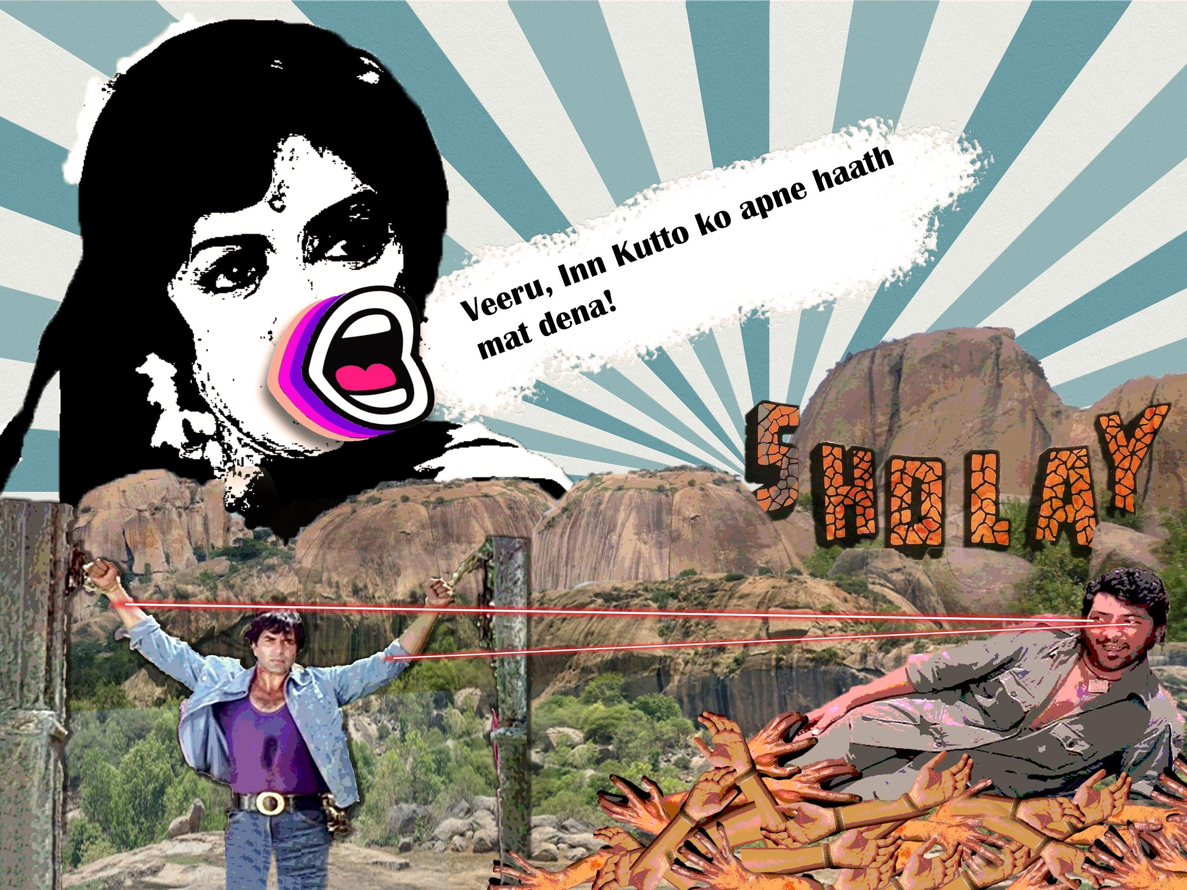
SHOLAY
Bring the attention of your audience over a key concept using icons or illustrations

Slide 13
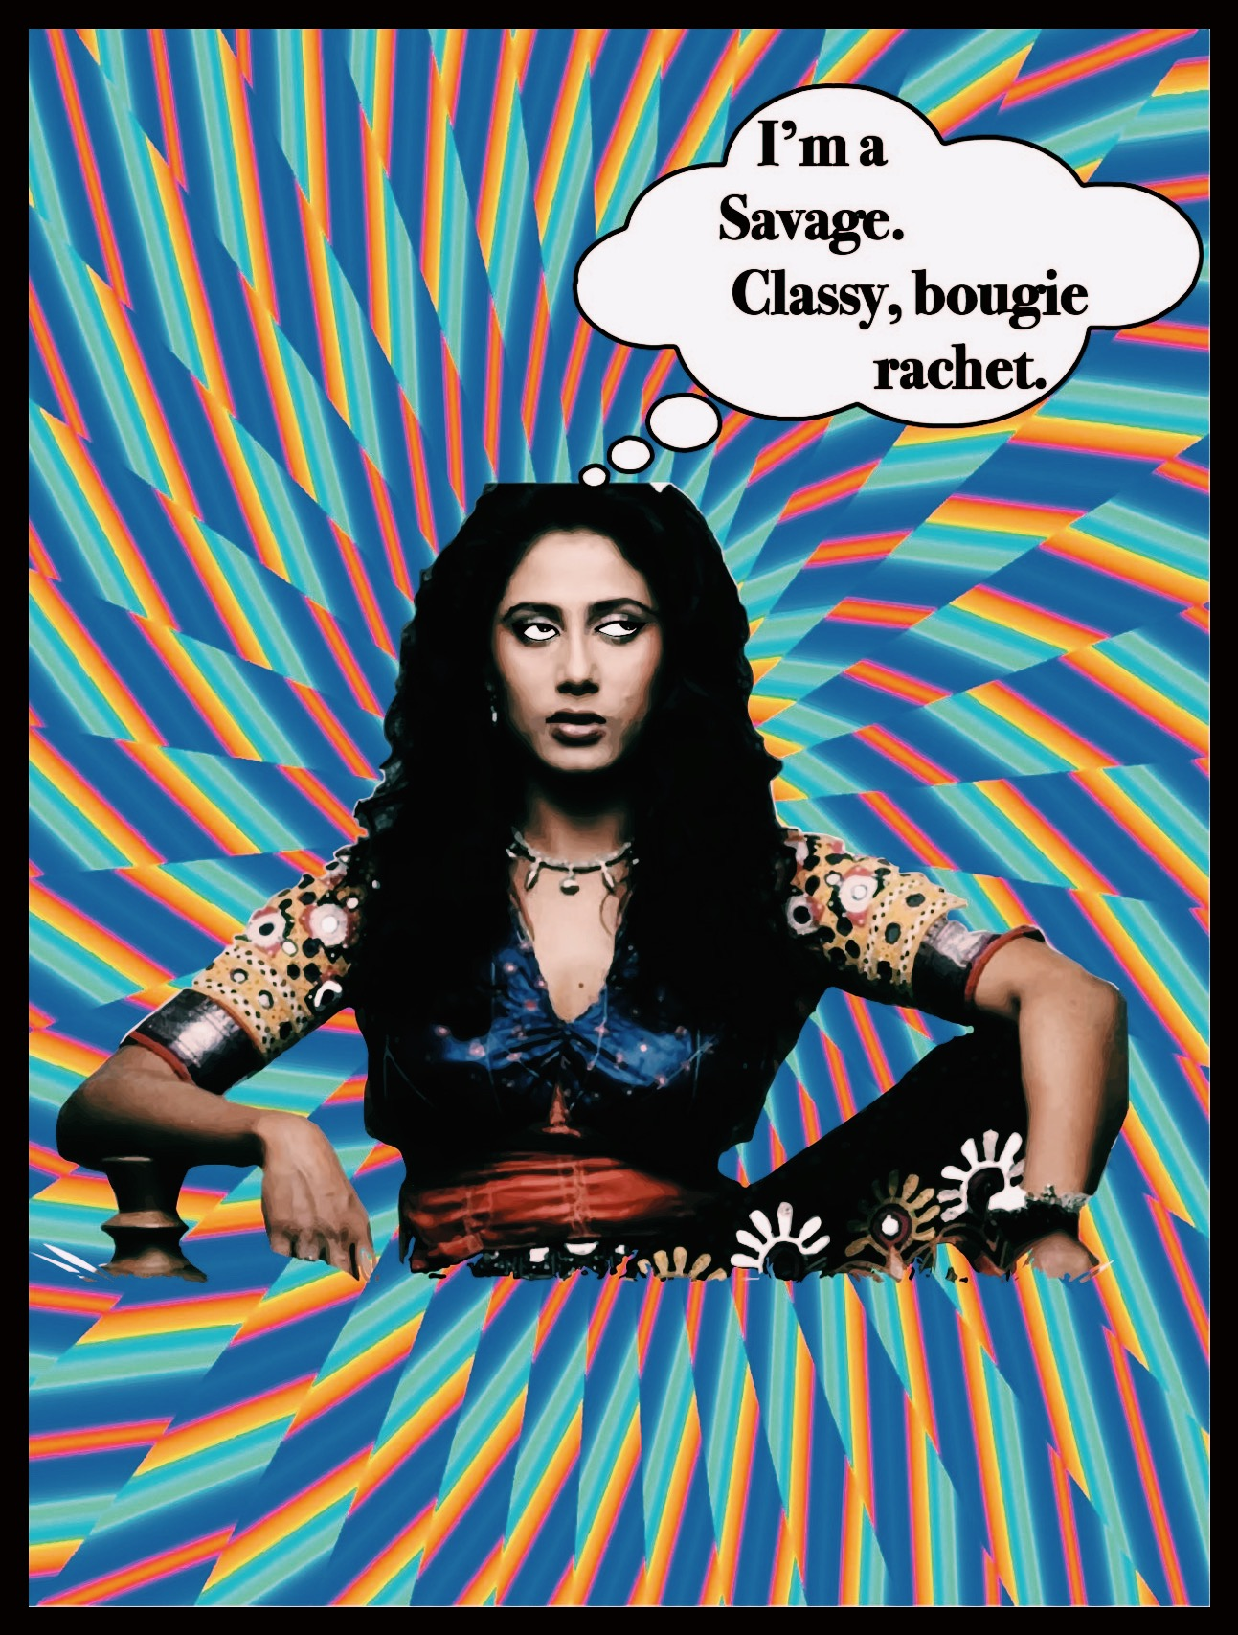
Bring the attention of your audience over a key concept using icons or illustrations
MANTHAN

Slide 14
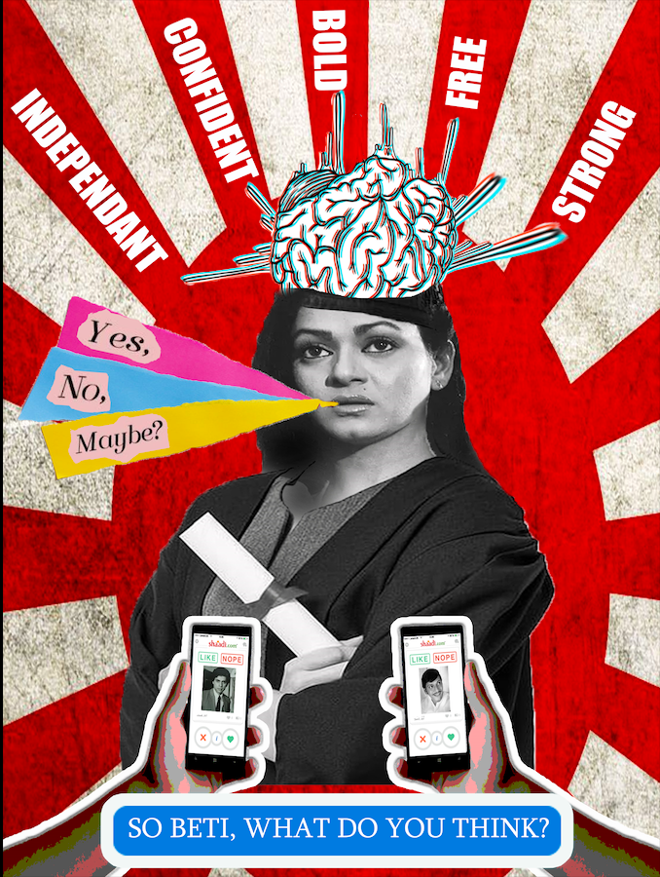
CHITCHOR
Bring the attention of your audience over a key concept using icons or illustrations

Slide 15
Explanations
Sholay
Manthan
The psychedelic poster of Smita patil with her eyes rolled symbolizes her character in the movie. Her sassy attitude is portrayed through this poster. Her character is very underrated. The thought bubble is a lyric from the song “Savage” by Meghan Thee Stallion. The posters have been made keeping the characters personality and how it would be depicted in today’s time.
Chitchor
The style of the poster is collage art. In this movie the female lead was given a choice to select her groom at the end. So i wanted to give it a modern approach to it. So the poster shows her education has given a rise in being a strong women.Thus her father thinks that she is eligible to choose her groom. She has the liberty to answer according to her choice.
This poster represents that in the movie, ‘Basanti’ emerges as a hero as she was not shy and was vocal of her thoughts. To showcase her outspoken and bold nature, a popular instagram shout out sticker has been used with a rhetorical comment for’ Veeru’ to not give his hands to ‘Gabbar’. On the other hand Gabbar is shown lying on a pile of dead hands as he was “obsessed “with cutting his enemies arms. The same way he is looking at Veeru’s arm seductively, wanting to cut it off through his laser eyes while Veeru is hanging there helplessly. The pile of dead hands also symbolizes his “chita” as his tyranny days were about to get over.

Slide 16
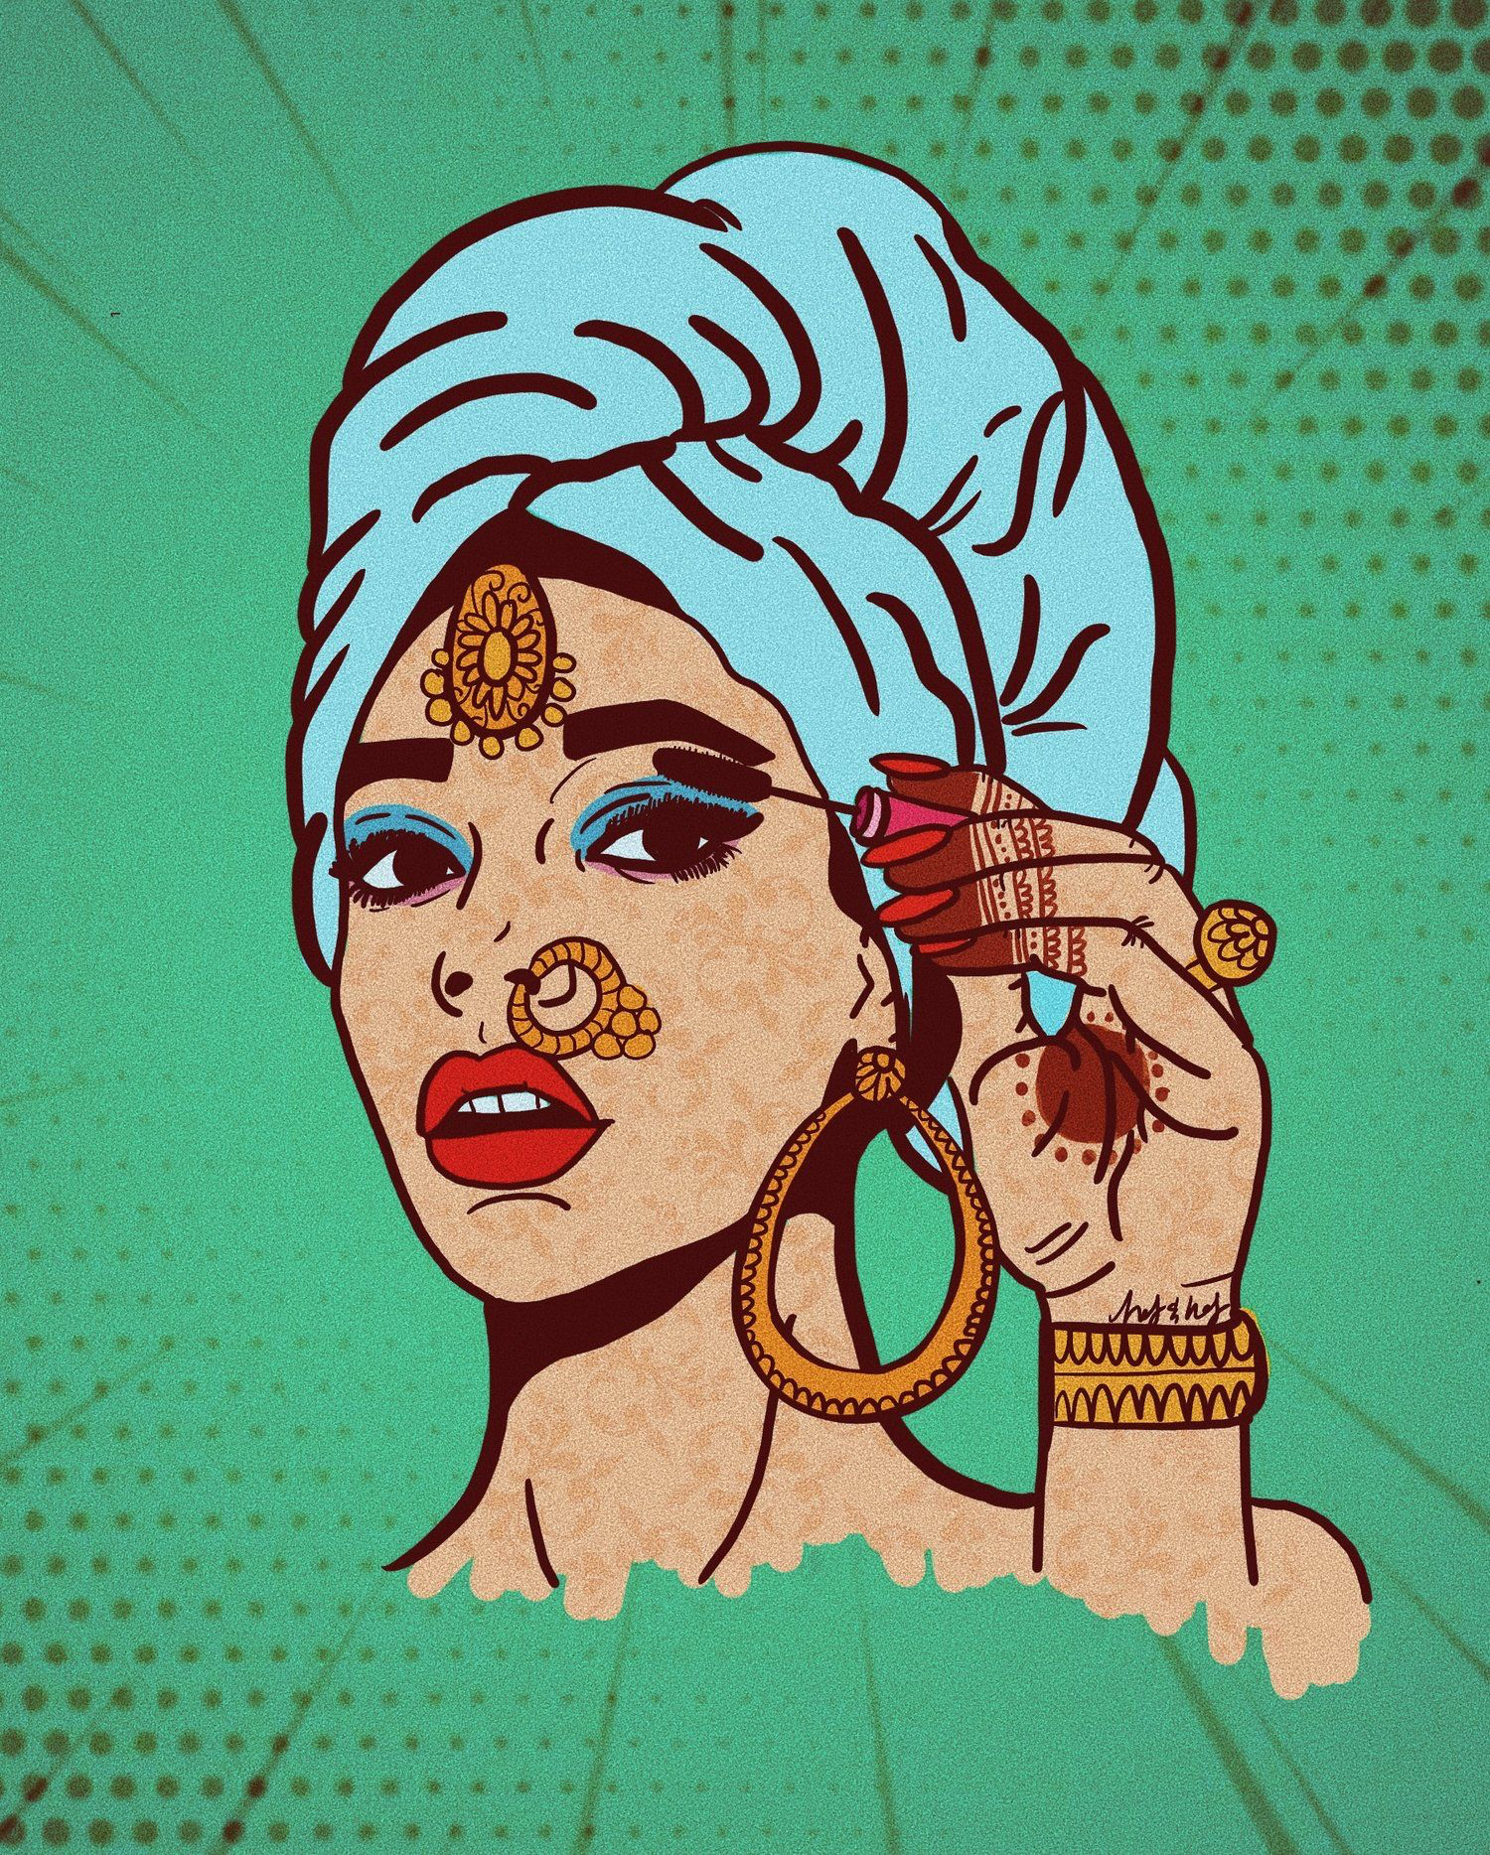
The rationale...
In all the movies that we watched, men were portrayed to be the alpha whereas the females weren’t dominating. Throughout all the movies, we can see the transition of the female voice being heard. The posters we made are to depict the females who played equally important parts in the movie, although did not receive the same amount of hype and recognition.

Slide 17
Process Work

Slide 18
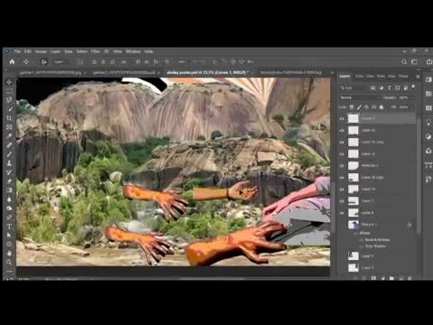
Sholay by Shristi

Slide 19
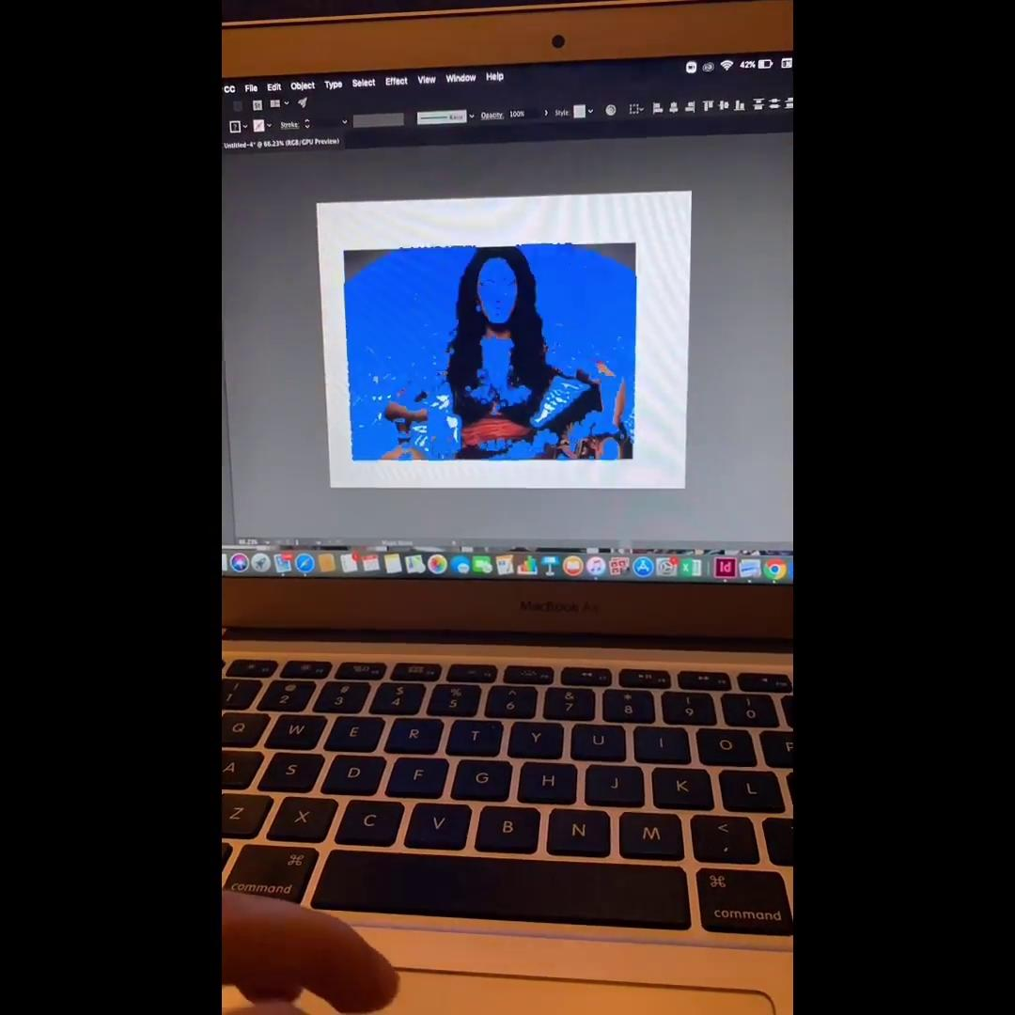
Manthan by Pronami

Slide 20

Chitchor by Suraksha

Slide 21
THANK YOU

